Slide 1



The Buyer's Roadmap:
Your Guide to a Confident Commercial Purchase
Prepared for Buyer – OG (Q 2026)

Slide 2
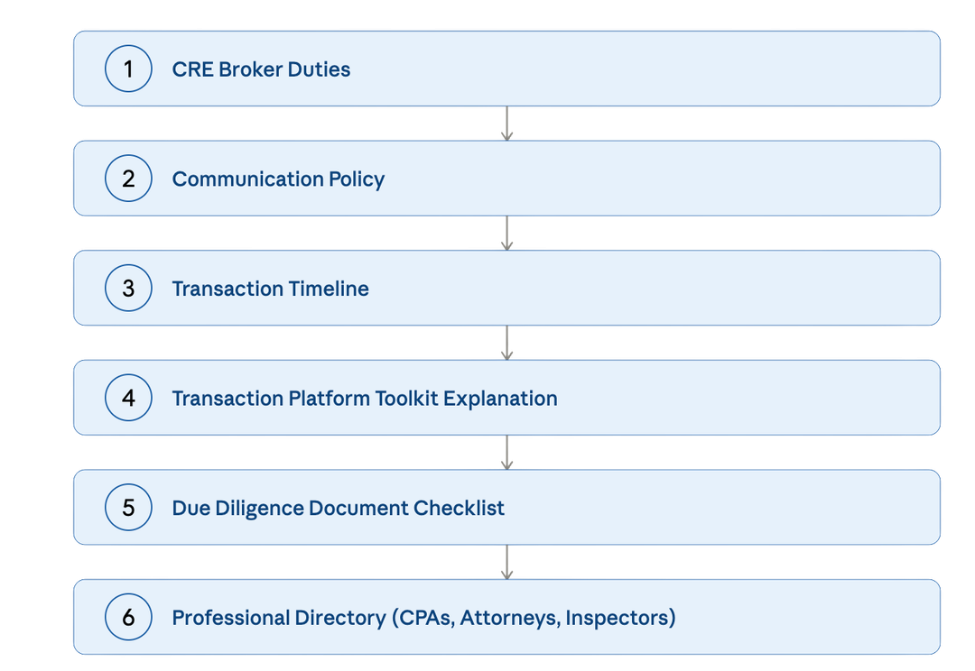

Appendix
Page 3
Page 6
Page 7
Page 8
Page 9
Page 9

Slide 3

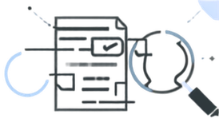
C O M M E R C I A L A C Q U I S I T I O N · W A R E H O U S E P U R C H A S E
CRE Broker Duties
Property Search & Market Analysis
Identify warehouse and industrial properties that fit your investment criteria.
Research:
  Asking prices
  Comparable Sales
  Market Activity
  Provide market information on rental rates, occupancy, location, and comparable properties.
  Help compare properties based on your investment objectives.
Offers, Negotiations & Due Diligence
  Arrange property tours and coordinate access with sellers or listing brokers.
  Prepare and present offers and Letters of Intent (LOIs), as appropriate.
  Assist with negotiations regarding inspections, due diligence, deposits, closing dates, and other contractual terms.
Transaction Coordination & Professional Resources
  Communicate with the seller, listing broker, title company, lender, and other transaction parties.
  Help keep the transaction organized and moving toward closing.
  Help identify areas requiring further investigation and coordinate with appropriate professionals for inspections, appraisals, surveys, and other due diligence.
  Connect you with qualified professionals, including commercial lenders, attorneys, CPAs/accountants, and inspectors.
What your broker Can Do:

Slide 4

C O M M E R C I A L A C Q U I S I T I O N · W A R E H O U S E P U R C H A S E
CRE Broker Duties
Guarantee Property Condition
A broker is not a property inspector, engineer, contractor, or environmental specialist.
Hire appropriate licensed professionals to investigate the property.
Provide Legal Advice
Your broker cannot act as your attorney or provide legal advice. Consult a qualified real estate attorney for legal advice.
Provide Tax or Accounting Advice or Guarantee Investment Performance
Financial projections should be independently evaluated by
appropriate professionals.Consult your CPA or tax professional
Guarantee Zoning or Permitted Use
Your broker can provide available information and help coordinate research, but cannot guarantee that a property will legally support
What your broker Cannot Do:

Slide 5


C O M M E R C I A L A C Q U I S I T I O N · W A R E H O U S E P U R C H A S E
CRE Broker Duties
Commercial real estate transactions can involve significant financial and legal considerations.
Independent professional advice is strongly recommended.
A successful commercial acquisition often requires more than a real estate broker.
YOUR BROKER
Real Estate Strategy • Property Search • Negotiation • Transaction Coordination
ATTORNEY
Contracts • Legal Structure • Legal Due Diligence
CPA
Taxes • Accounting • Financial Analysis
LENDER
Financing • Loan Terms • Underwriting
INSPECTOR / ENGINEER
Physical Condition • Building Systems • Structural Evaluation
ENVIRONMENTAL CONSULTANT
Environmental Due Diligence • Site Assessment
TITLE COMPANY / ATTORNEY
Title • Escrow • Closing • Deed & Recording
Your professional Team:
Your Broker's Goal:
To help you make an informed real estate decision, protect your interests within the scope of our brokerage role, negotiate favorable transaction terms, and coordinate the real estate process from property search through closing.
This flyer is intended for general informational purposes and does not constitute legal, tax, accounting, engineering, environmental, inspection, lending, or investment advice. Buyers should conduct their own independent due diligence and consult the appropriate licensed professionals before purchasing commercial real estate.

Slide 6
C O M M E R C I A L A C Q U I S I T I O N · W A R E H O U S E P U R C H A S E
Communication Policy
To ensure a smooth, organized, and transparent transaction, email is our formal and official method of communication. While WhatsApp messages, text messages, and phone calls may also be used for convenience, quick questions, reminders, and time-sensitive matters, all important updates, documents, instructions, and transaction-related decisions will be communicated via email whenever appropriate.
Clients are expected to regularly review and respond to emails in a timely manner. A response to an email will serve as confirmation that the communication has been received and reviewed. This helps ensure that important information, deadlines, documents, and decisions are properly documented and can be easily referenced throughout the transaction.
Using email as our primary method of formal communication allows us to maintain clarity, accountability, organization, and efficiency while providing a seamless experience from the beginning of the transaction through closing.
Why this matters:
Commercial deals move fast and involve tight deadlines — inspection periods, financing contingencies, closing dates.
A written trail protects both of us if a date or detail is ever in question, and ensures nothing falls through the cracks during your transaction.

Slide 7

















C O M M E R C I A L A C Q U I S I T I O N · W A R E H O U S E P U R C H A S E
Transaction Timeline
Buyer Representation Agreement
Pre-Approval for financing
Property Search
& Selection
Property Analysis & Due Diligence
Submit Offer &
Negotiate Terms
Execute Contract & Start Inspections
Finalize Financing, Title & Closing Requirements
Closing
Sign Buyer Representation Agreement & provide broker with the required questionnaires & financial information needed to begin the search process.
Get the LOI/Term sheet from y your lender or proof of funds letter from financial institution
I will share curated listings through our platforms for viewing active and new listings in real time. You can favorite properties, track new listings, and share feedback directly with me.
Once you find your favorites, I’ll provide reports offering in-depth insights on property values, neighborhood trends, and comparable sales. We’ll tour listings the top ones that match your preferences.
Once you’ve found the one, I’ll guide you through crafting a strong offer and negotiating terms on your behalf.
We’ll coordinate inspections and
ensure the appraisal aligns with your offer price. I’ll help you navigate any repair requests or negotiations that arise
Our lender finalizes
your loan, and
we stay in touch with the title company to ensure all conditions
are met smoothly.
You’ll sign the final documents,
Get your keys, and officially become
a warehouse owner!
Commercial real estate transactions can vary significantly depending on the property, financing, purchase contract, and parties involved. The timeline below provides a general overview of the steps typically involved in a commercial property purchase and is intended for informational purposes only, to provide a general understanding of the process and what to expect.

Slide 8
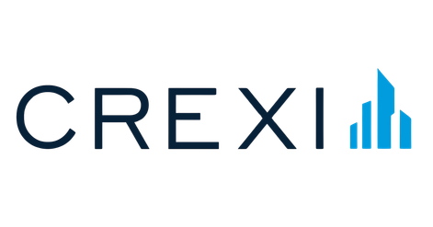






C O M M E R C I A L A C Q U I S I T I O N · W A R E H O U S E P U R C H A S E
Your Transaction Toolkit
Every platform below plays a role in getting your warehouse acquisition from search to
close. — you'll be dropping in and out of these throughout the deal.
Search & Market Research
Verified Comps & Property Data
Documents & Transaction Management
Google Sheets
DotLoop
A commercial real estate marketplace used to search for properties for sale and lease.
A cloud-based spreadsheet tool used to organize and track the property search. We can use it to compare properties, track pricing and property details, organize tours, and keep notes on potential opportunities.
Review, sign, and track all documents securely online
Google Drive
A CRE marketplace used to find and market properties for sale or lease. It is particularly useful for identifying available warehouse, industrial, office, retail, commercial properties.
All transaction-related documents will also be available in a Google Drive folder, which you can download for your records
Analyst Pro
A commercial real estate analysis platform used to evaluate and underwrite properties. Exported reports pertaining to your listing will be emailed to you
Access CRE listings, favorite properties, and receive updates

Slide 9
C O M M E R C I A L A C Q U I S I T I O N · W A R E H O U S E P U R C H A S E
Due Diligence Document Checklist
All Documents related to your transaction will be shared via DotLoop for record-keeping purposes
Required From
Document Type
Buyer
Government Issued I.D.
Buyer
Entity Formation Documents
(LLC, Corporation or Partnership)
Buyer
Operating Agreement Or Bylaws
(If purchasing through an entity)
Buyer
Proof of Funds
(Bank Statements, line of credit, etc.)
Buyer
Pre-Approval Letter
Buyer
Letter of Intent (LOI) +
Purchase & Sale Agreement

Slide 10
C O M M E R C I A L A C Q U I S I T I O N · W A R E H O U S E P U R C H A S E
Professional Directory
Real Estate Attorney & Title Company
Inspections & Surveying
Financing & CPAS

